Slide 1
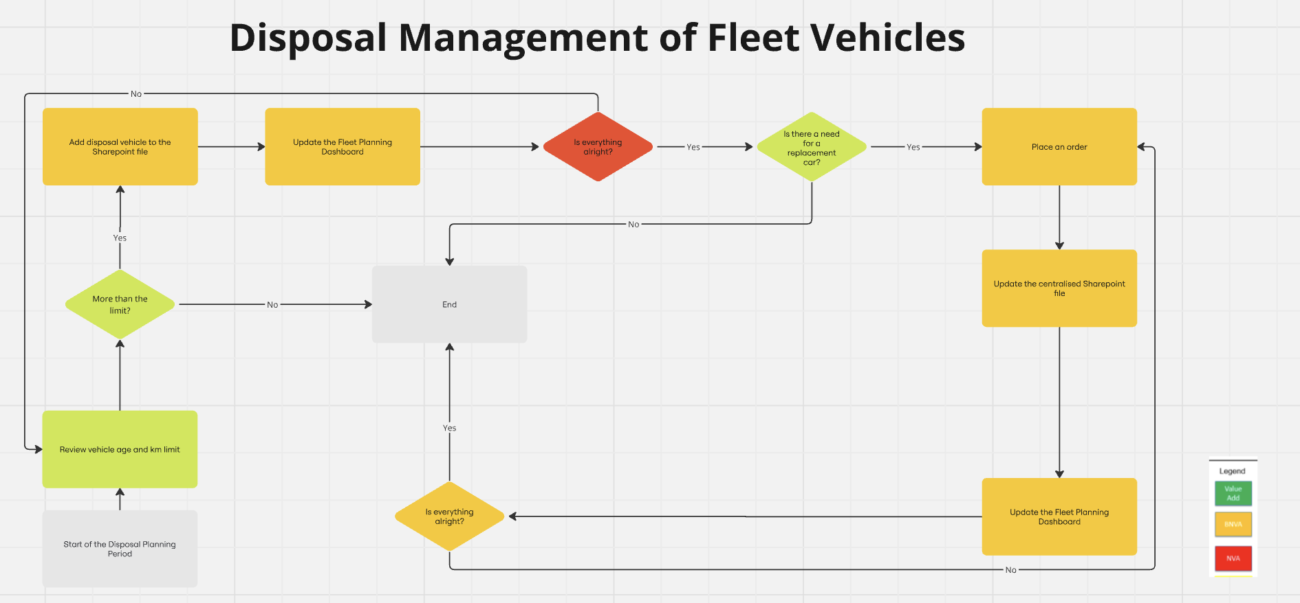
Assignment 02
Activity Process Map
Lean Six Sigma Green Belt Course

